Slide 1
DRUG REVIEW DATASET
Nikita Pai

Slide 2
About the data
The drug review dataset refers to a collection of data containing reviews or feedback from individuals about various pharmaceutical drugs or medications.

Slide 3
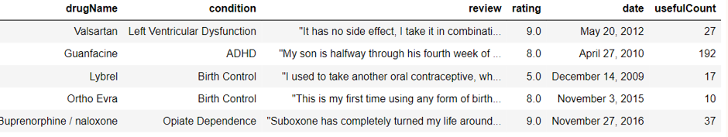
WHAT IS IN THE DATA?
Dataset consists of train data (161 k rows) & test data (53k rows)
Date range is between April 1st, 2008 to Sept 9th, 2017
For exploratory text analysis, test and train dataset has been combined together

Slide 4
BUSINESS USERS & CASE
Practitioner | Regulatory Bodies | Drug Companies
Drug Comparison
Common Keywords
Sentiment Analysis
Sentiment
Classification
Adverse Event
Classification

Slide 5
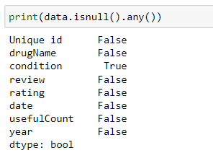
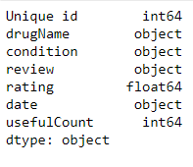
Data CLEANING
No Duplicates found
Checked for columns having null values
Corrected date format using datetime() function

Slide 6
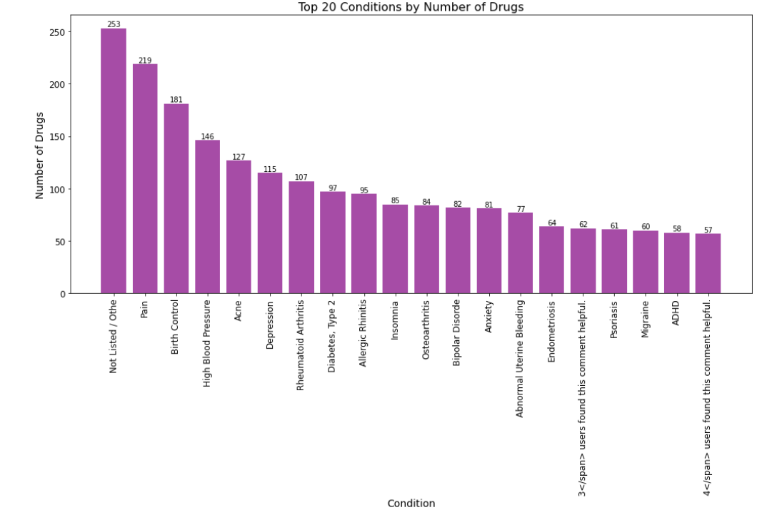
Data FILTERATION
Condition column contained the following discrepancies which represented 1.37% of the data
Null Values
Values named as “Not Listed”
Misrepresented rows containing “users found this comment helpful”

Slide 7
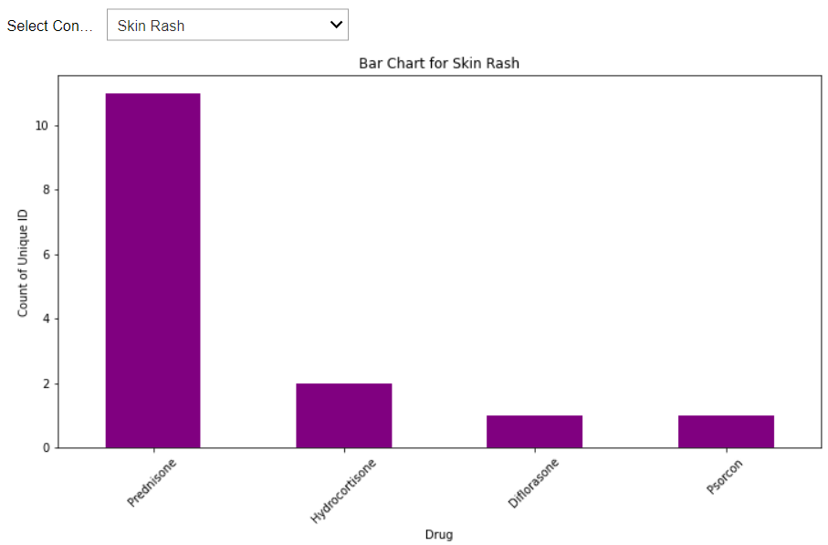
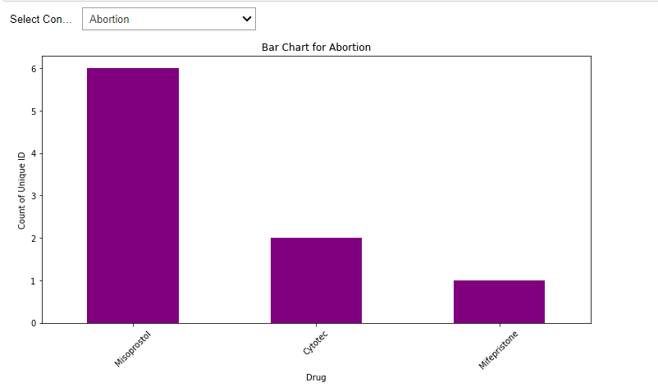
DRUG COMPARISIOM INTERACTIVE PLOTS
DERMATOLOGY DEPT
GYNACOLOGY DEPT

Slide 8
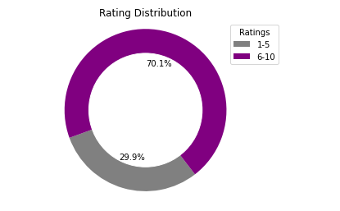
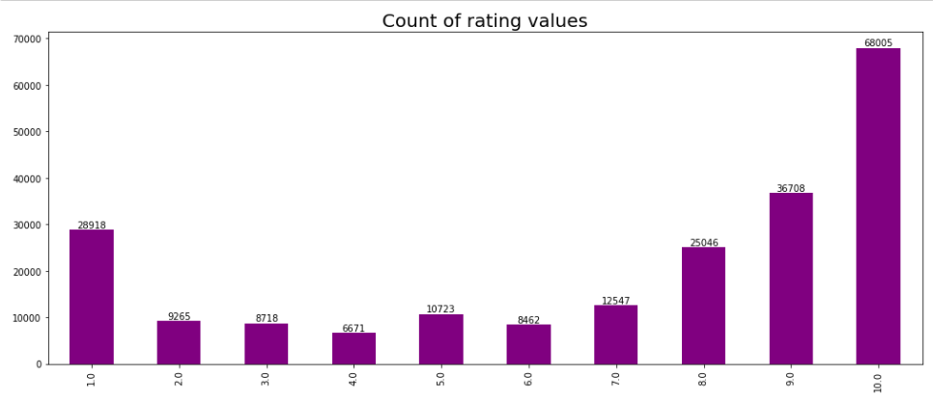
RATING BIAS
The data has bias towards the positive ratings
Almost 70% of the data has medication rating between 6-10

Slide 9
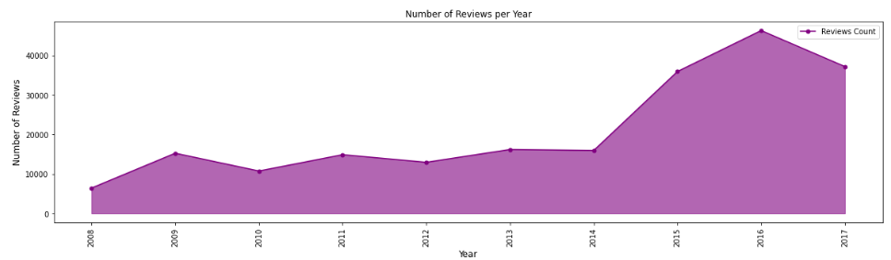
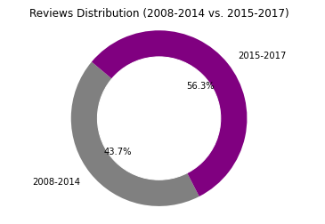
ReviewS per year
The reviews have peaked up from 2015-2017, more than 50% of the data will represent the latest trend
The slight dip in 2017 is because the data from year 2017 is till September

Slide 10
DATA PREPROCESSING
Lower Casing
Removing Whitespaces & punctuation
Tokenization
Removal of
Stopwords & HTML entity
Vectorization

Slide 11
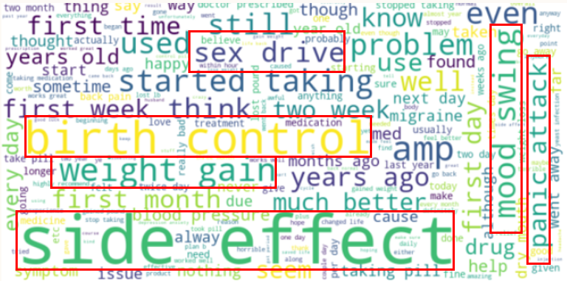
Word CLOUD

Slide 12
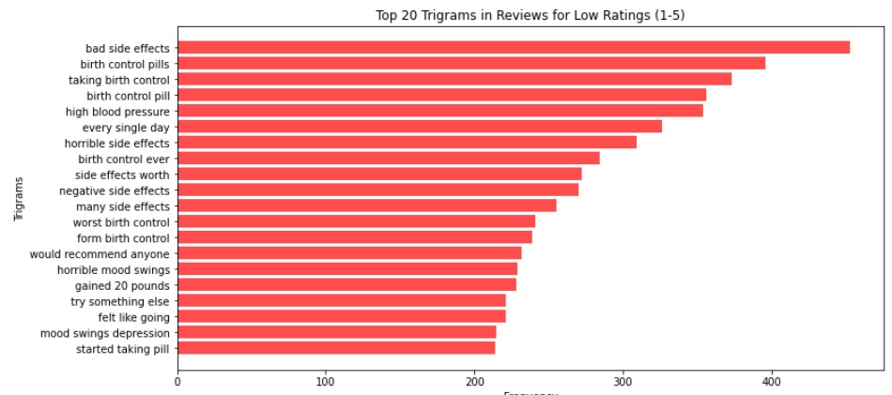
TRIGRAM LOW RATINGs

Slide 13
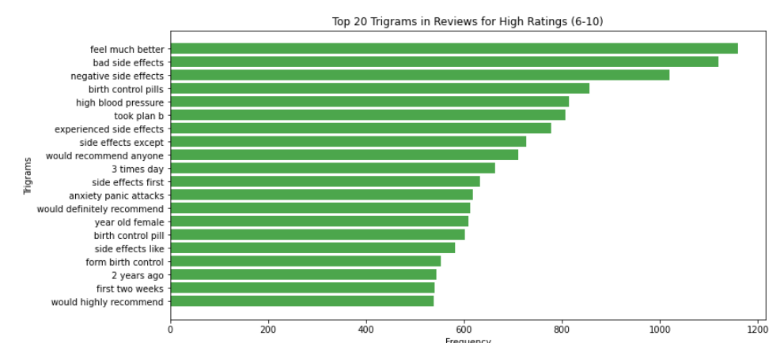
TRIGRAM HIGH RATINGs

Slide 14
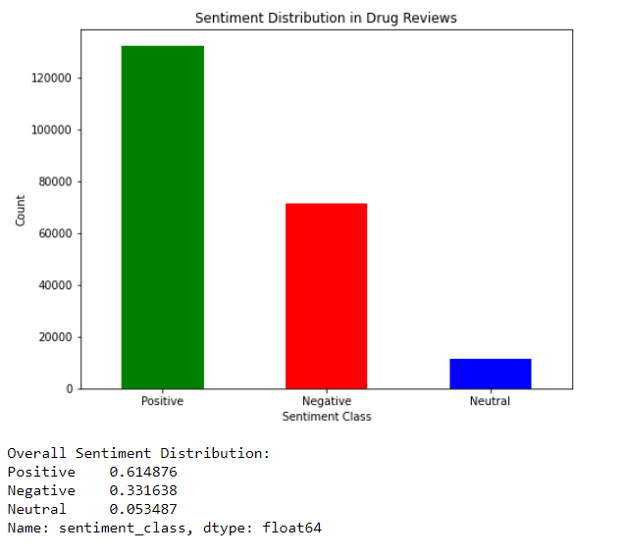
Rating vs. Sentiment ANALYSIS
61 % of the data is positively biased
33% of data is negatively biased
5% of data is neutral

Slide 15
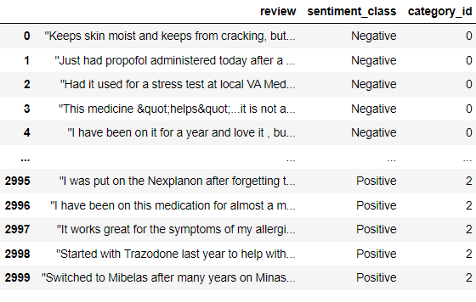
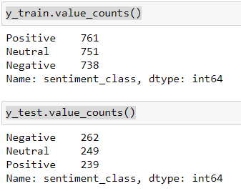
TEXT CLASSIFICATION PREPROCESSING
Extracted 1000 samples from positive, negative and neutral category to avoid model bias

Slide 16
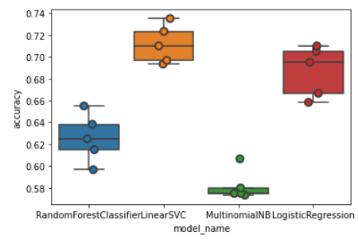
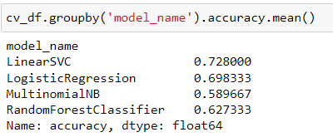
MODEL PERFORMANCE EVALUATION
Ran the training sample against Random Forest Classifier, Linear SVC, Multinomial NB and Logistic Regression
Best Accuracy was given out by Linear SVC with 72% accuracy

Slide 17
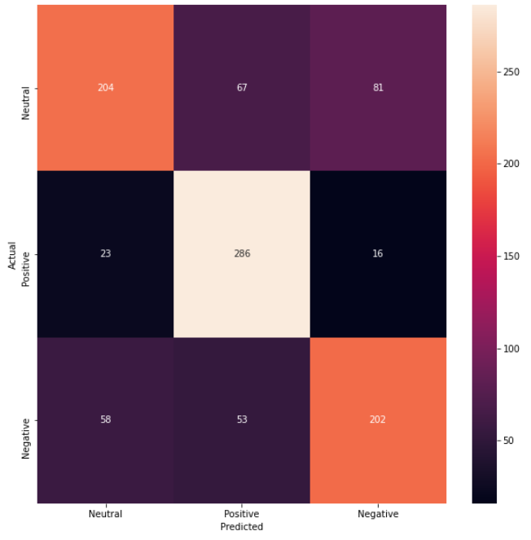
CONFUSION MATRIX
Accuracy for Neutral:
Predicted Neutral/ Actual Neutral
= (204)/(204+67+81)
= 57%
Accuracy for Positive: 88%
Accuracy for Negative: 67%

Slide 18
ADVERSE EFFECT IDENTIFICATION
Keywords taken into consideration for extracting relevant data are as follows:
Minimal Side Effect: “My son took 10 mg Aspirin and had minimal side effect like headache”
Major Side Effect: “I had the worst side effects with this medicine as I ended up with insomnia”
side effect | adverse effect | adverse reaction

Slide 19
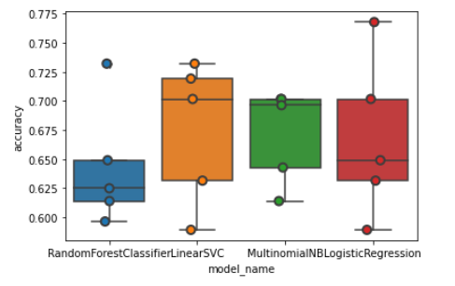
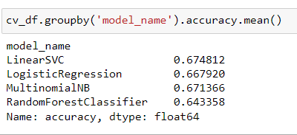
SAMPLING & MODEL EVALUATION
Took 300 of samples out from the dataset and manually accounted flags to separate out major side effect reviews from minimal to no side effects
Ran the training sample against Random Forest Classifier, Linear SVC, Multinomial NB and Logistic Regression

Slide 20
FUTURE SCOPE
Add ratings & Useful count along with reviews as features to improvise the accuracy score
How popular was a particular drug in 2008 vs 2017
Add more samples to the adverse effect data, add hyperparameter tuning
Add explainability to the output of model

Slide 21
THANK YOU

